Slide 1

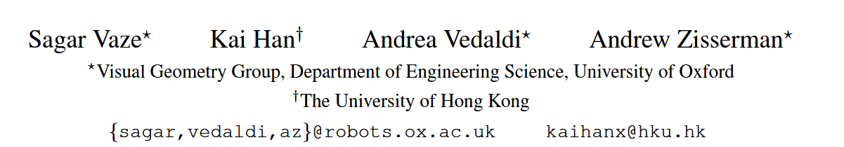
Generalized Category Discovery
CVPR 2022

Slide 2

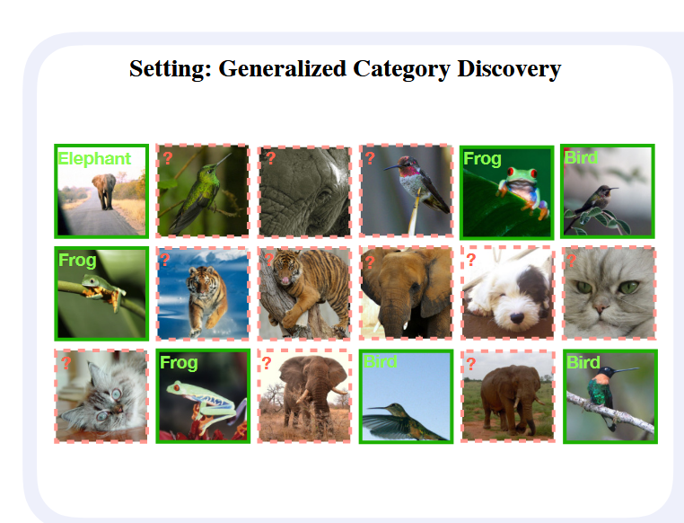
Background
Existing recognition methods are not able to deal with this setting, because they make several restrictive assumptions, such as the unlabelled instances only coming from known – or unknown – classes, and the number of unknown classes being known a-priori. We address the more unconstrained setting, naming it ‘Generalized Category Discovery’, and challenge all these assumptions.

Slide 3
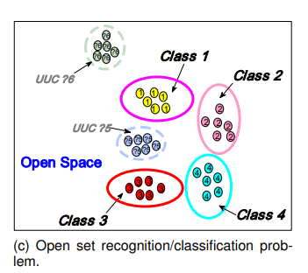
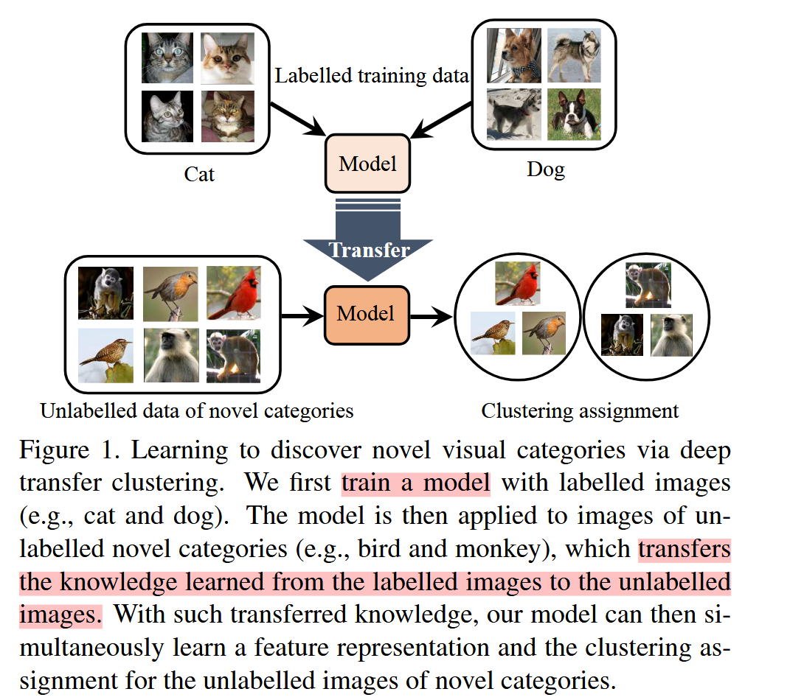
Background
open-set recognition (OSR)
novel-category discovery (NCD)
项目 | OSR（开放集识别） | NCD（新类发现） | GNCD（广义新类发现）
是否有标签数据 | ✅ 仅包含已知类 | ❌ 完全无标签（只包含新类） | ✅ 有标签（已知类）+ 无标签（混合）
核心任务目标 | 区分“已知类”与“未知类”，未知类拒识 | 在无标签数据中聚类出新类结构 | 在混合数据中分类已知类，聚类新类
是否做新类分类 | ❌ 不需要 | ✅ 聚类发现 | ✅ 聚类发现
是否分类已知类 | ✅ 是 | ❌ 否 | ✅ 是
输入测试数据 | 仅测试阶段含未知类 | 仅新类无标签数据 | 混合：已知类+未知类，无标签

Slide 4
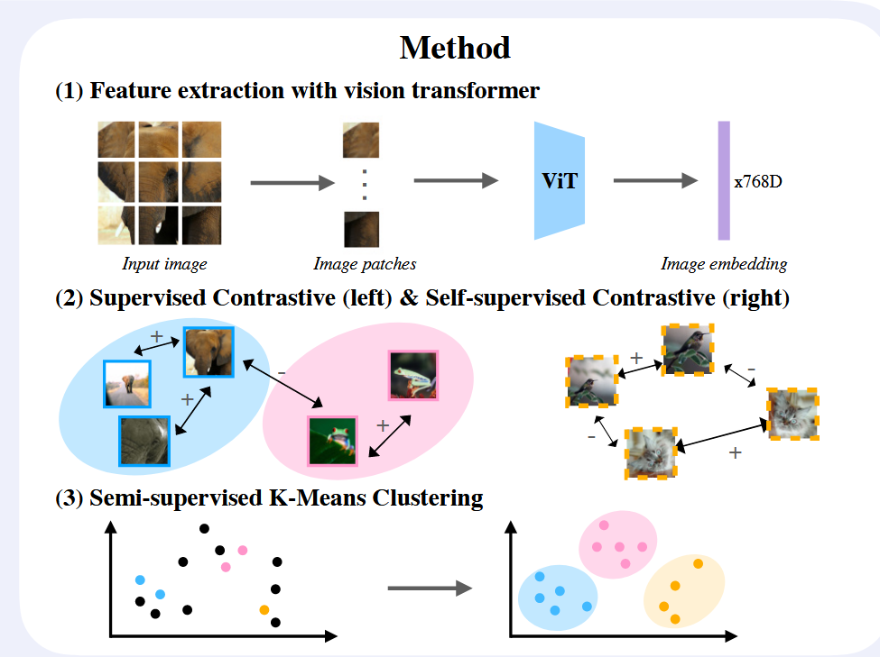
Methods
_{有标签：}$D_{L=}{\{(x_{i},y_{i})\}}_{I=1}^{N}∈X x$ $y_{L}$ _{无标签：}$D_{U=}{\{(x_{i},y_{i})\}}_{I=1}^{M}∈X x y_{U}$

Slide 5
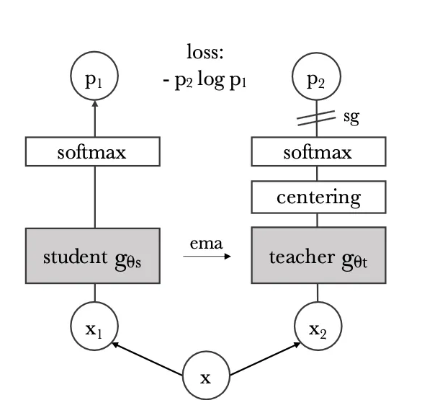
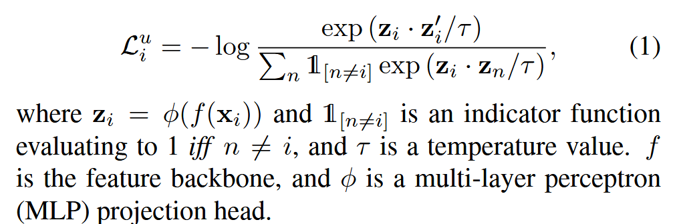
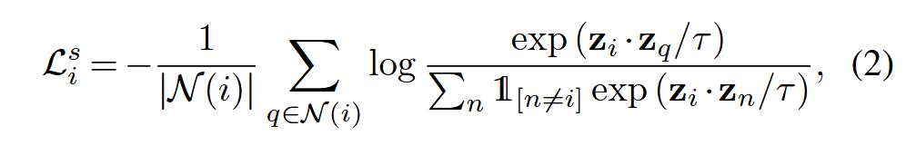
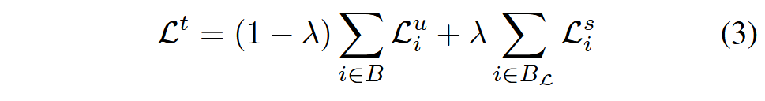
Methods
（1）Representation learning
① Unsupervised contrastive loss
② Supervised contrastive loss
DINO架构图
③ Total loss
Notes:
使用的是 ViT 模型（ViT-B/16 架构），但这个 ViT 是使用 DINO 进行自监督预训练得到的

Slide 6
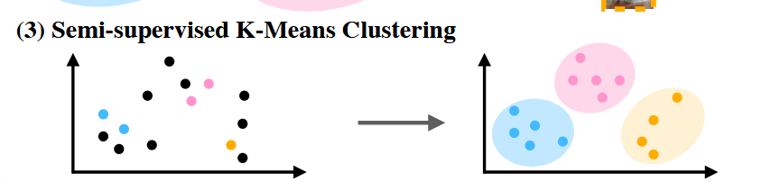
Methods
（2）Label assignment with semi-supervised k-means
Instead of performing this parametrically as is common in NCD (and risk overfitting to the labelled data) we propose to use a non-parametric method.
Label kmean
instances from the same class in DL are always forced to have the same cluster assignment
UnLabel kmean++
each instance in DU can be assigned to any cluster based on the distance to different centroids

Slide 7

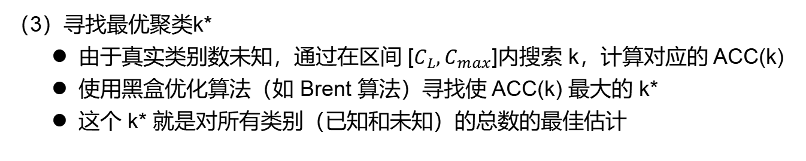
Methods
（3）Estimating the class number in unlabelled data
问题
在 NCD 和无监督聚类设置中，通常假设事先知道数据集中的类别数量，但这在现实世界中是不现实的，因为标签本身是未知的
具体步骤
（1）对数据集进行聚类
对整个数据集 D，使用 k-means 聚类算法进行聚类，设定不同的聚类簇数 k
每次聚类后，得到每个样本的聚类标签
（2）计算聚类准确率 ACC(k)
只利用带标签的子集 D_{L}，将其聚类标签与真实标签进行匹配；
使用匈牙利算法（Hungarian algorithm）实现聚类标签与真实标签的一对一最优匹配；
统计匹配后 D_{L} 上的分类准确率，作为 ACC(k)
（3）寻找最优聚类k*
由于真实类别数未知，通过在区间 [$C_{L},C_{max}$]内搜索 k，计算对应的 ACC(k)
使用黑盒优化算法（如 Brent 算法）寻找使 ACC(k) 最大的 k*
这个 k* 就是对所有类别（已知和未知）的总数的最佳估计
$$k^{∗}=arg\max_{k}{ACC(k)}$$

Slide 8
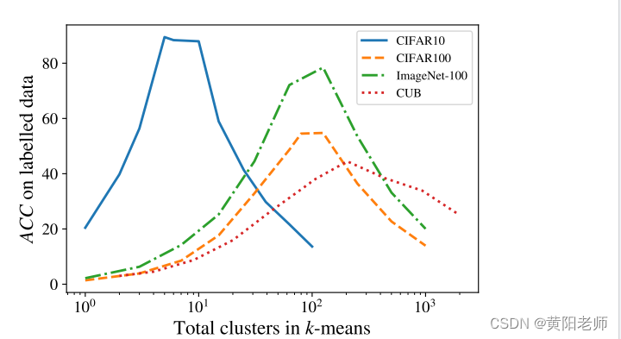
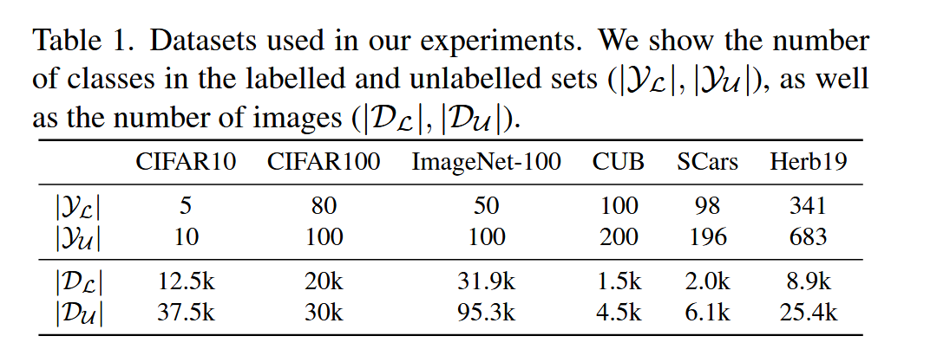
Methods
Total clusters in k-means

Slide 9
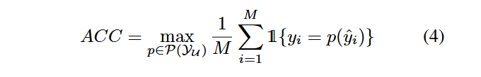
Experiments
BaseLines
① RankStats+
RankStats trains two classifiers on top of a shared feature representation: the first head is fed instances from the labelled set and is trained with the cross-entropy loss, while the second head sees only instances from unlabelled classes (again, in the NCD setting, the labelled and unlabelled classes are disjoint).
②UNO+
Similarly to RankStats, UNO is trained with classification heads for labelled and unlabelled data. The model is then trained in a SwAV-like manner.
Evaluation protocol
使用 匈牙利算法（Hungarian algorithm） 实现的，它用于在预测簇和真实类之间找出最佳一一对应关系

Slide 10
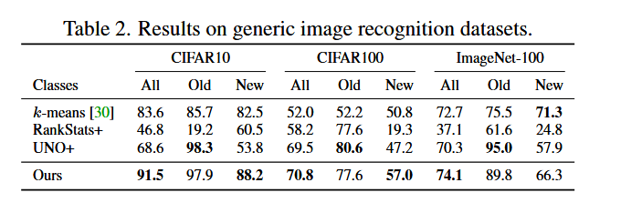
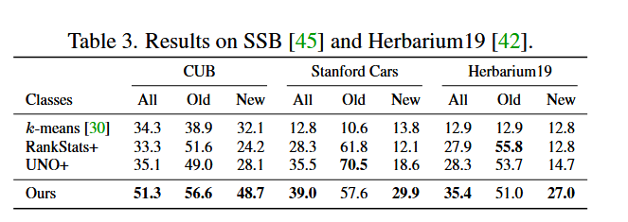
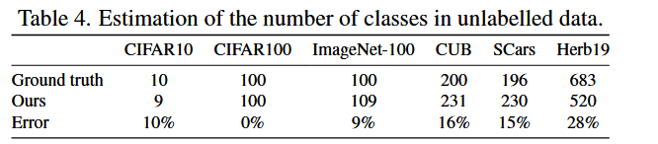
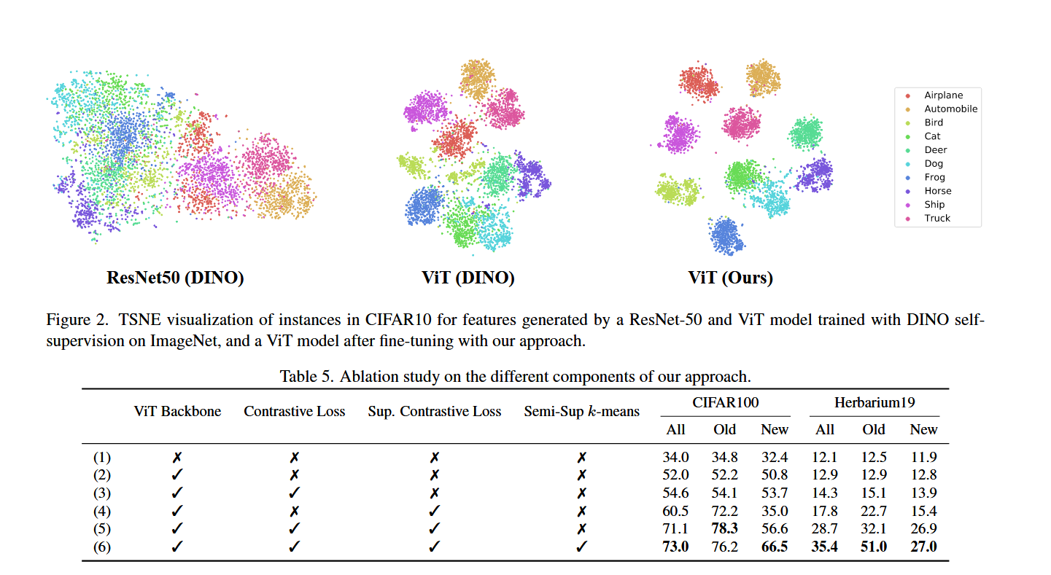
Experiments
Semantic Shift Benchmark (SSB, including CUB and Stanford Cars）

Slide 11
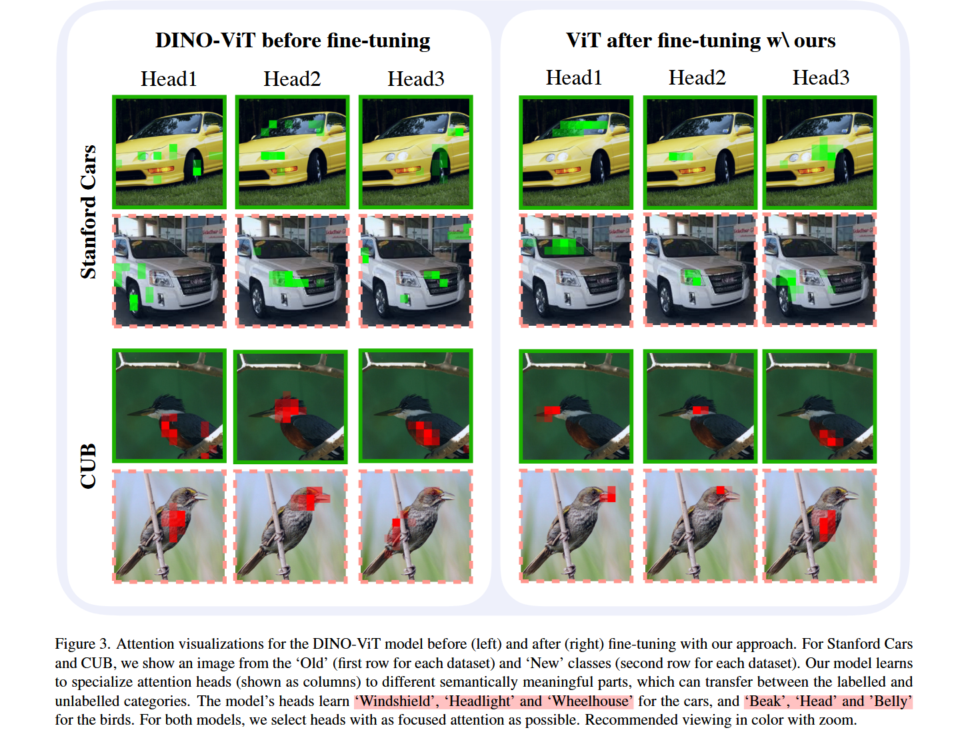
Experiments

